Slide 1

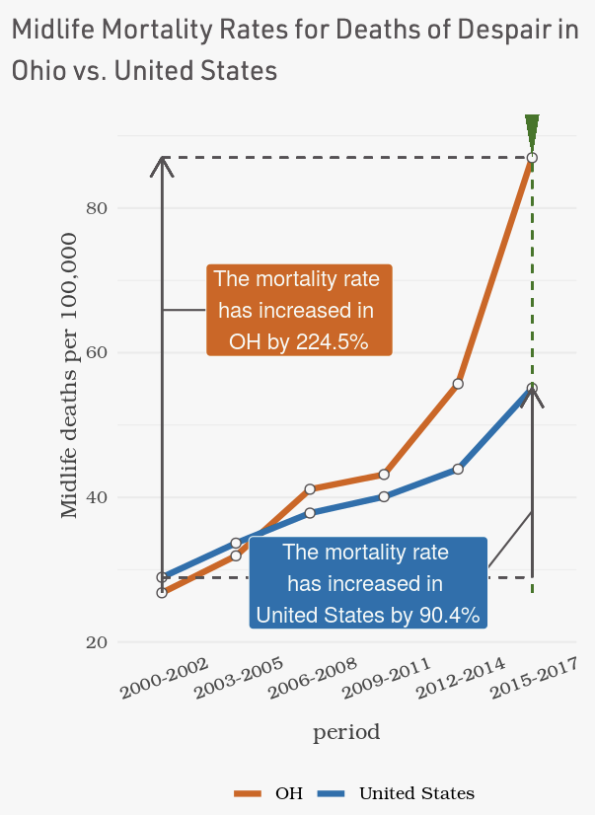
Open source web application enabling healthcare researchers, providers, payers, and policy makers to gain actionable insights into how, where, and why mortality rates are rising in the United States (US)
Explores mortality trends for midlife adults ages 25-64 across the United States from 2000 to 2017.
Identifies social and economic factors associated with increased mortality trends at the county-level for US and individual states.
Visualizations demonstrate determinants and their impact on mortality trends.
Web app: Demo Video:
MortalityMinder.idea.rpi.edu
http://bit.ly/mortalityminder_video_final

Slide 2
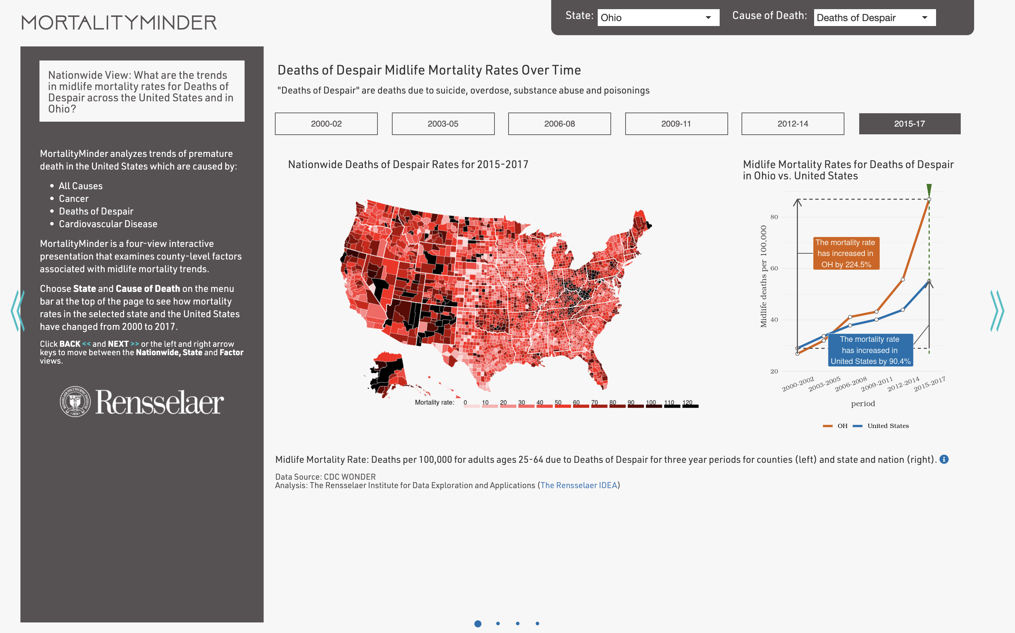
National View: Reveals national and state mortality rate trends through time
User selects Cause of Death and State or United States.
Question answered by view.
User selects time period
Rate Graph compares change in state and national midlife mortality rates from 2000-2017.
Users can get more details in the State and Factor view by clicking << or >> or using left or right arrows.
Data for age-specific mortalities are from CDC WONDER.
US map of county-level midlife mortalities exhibits regional disparities in mortality.

Slide 3
Data Sources and Preparation
Mortality Rate Data (2000-2017) from Wonder.CDC.org
County-level Social and Economic Factors from CountyHealthRankings.org
Selected crude midlife mortality rate data of adults ages 25-64 per county because it demonstrates actual premature mortality rates experienced by Americans.
Calculated mortality rates in three-year chunks from CDC Wonder Detail to reveal trends and avoid data suppression by CDC. Suppressed data was imputed.
Used national, state and county rates for major causes of death: Cancer, Cardiovascular Disease, Deaths of Despair (suicide and self harm), and All Cause.
Downloaded factors from over 20 primary sources gathered by CountyHealthRankings.org, maintained by the Robert Woods Johnson Foundation.
Started with 150+ factors addressing health behaviors, clinical care, education, employment, social supports, community safety, and physical environments.
Reduced to ~70 factor by curating and limiting to those correlating with at least one cause of death at the national level.
Descriptions linked to primary sources.
MortalityMinder is open source and easily expands to other age-adjusted, age-specific, and group-specific mortality rates, death causes, and/or features.

Slide 4
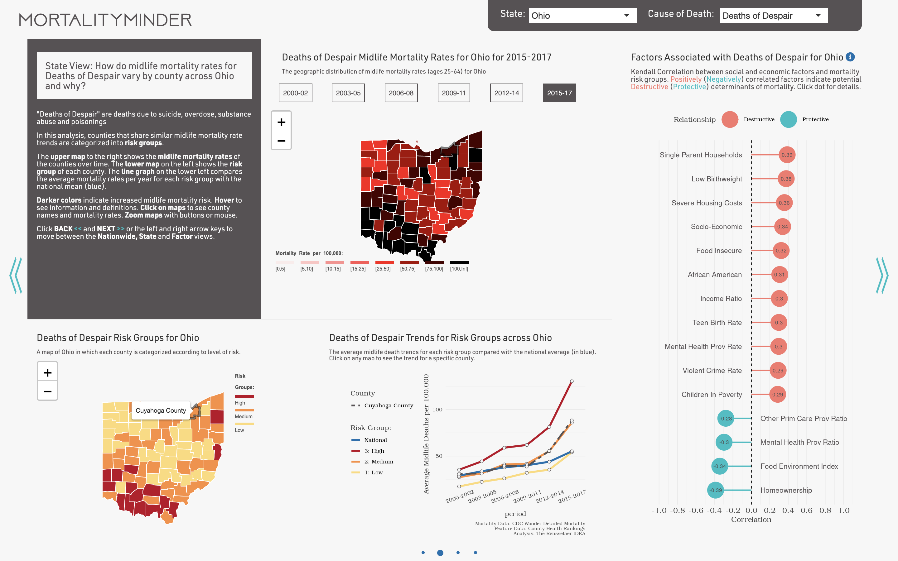
State View: Summarizes a specific states mortality trends and disparities
User selects time period shown in the Mortality Rate Map.
Trend Graph summarizes regional disparities through time by plotting mean mortality rates for each risk group. User can compare risk groups to see if better or worse than the national average (Blue). Selected county is the dotted line.
Counties that share similar midlife mortality rates are categorized into Risk Groups.
Map showing counties colored by risk groups reveals regional disparities.
Counties with suppressed data do not appear on the Trend Graph. Imputed values are used to create maps.
User selects specific county to see its name and how it compares to state and nation on Trend Graph.

Slide 5

State View: Reveals county-level social and economic factors associated with midlife mortality rates
Hover on dot to see factor definition. Click on dot to see details in Factor View.
Performs rigorous association study by ordering county Risk Groups by 2015-2017 mortality rate, and computes Kendall Tau Correlation between Factors and Risk Groups.
Reports up to 15 most significantly (p-value < .05) associated factors.
Analysis method of combining Risk Group clustering by K-means with Kendall Correlation was selected for robustness, rigor, and effectiveness.
Alternative analysis methods easily added to open source architecture.
Limitation: Associated factors are correlated to midlife mortality rates. Further investigation is needed to see if they are actual determinants of mortality.
Positively-correlated factors are potential Destructive Determinants of mortality.
Negatively-correlated factors are potential Protective Determinants of mortality.

Slide 6
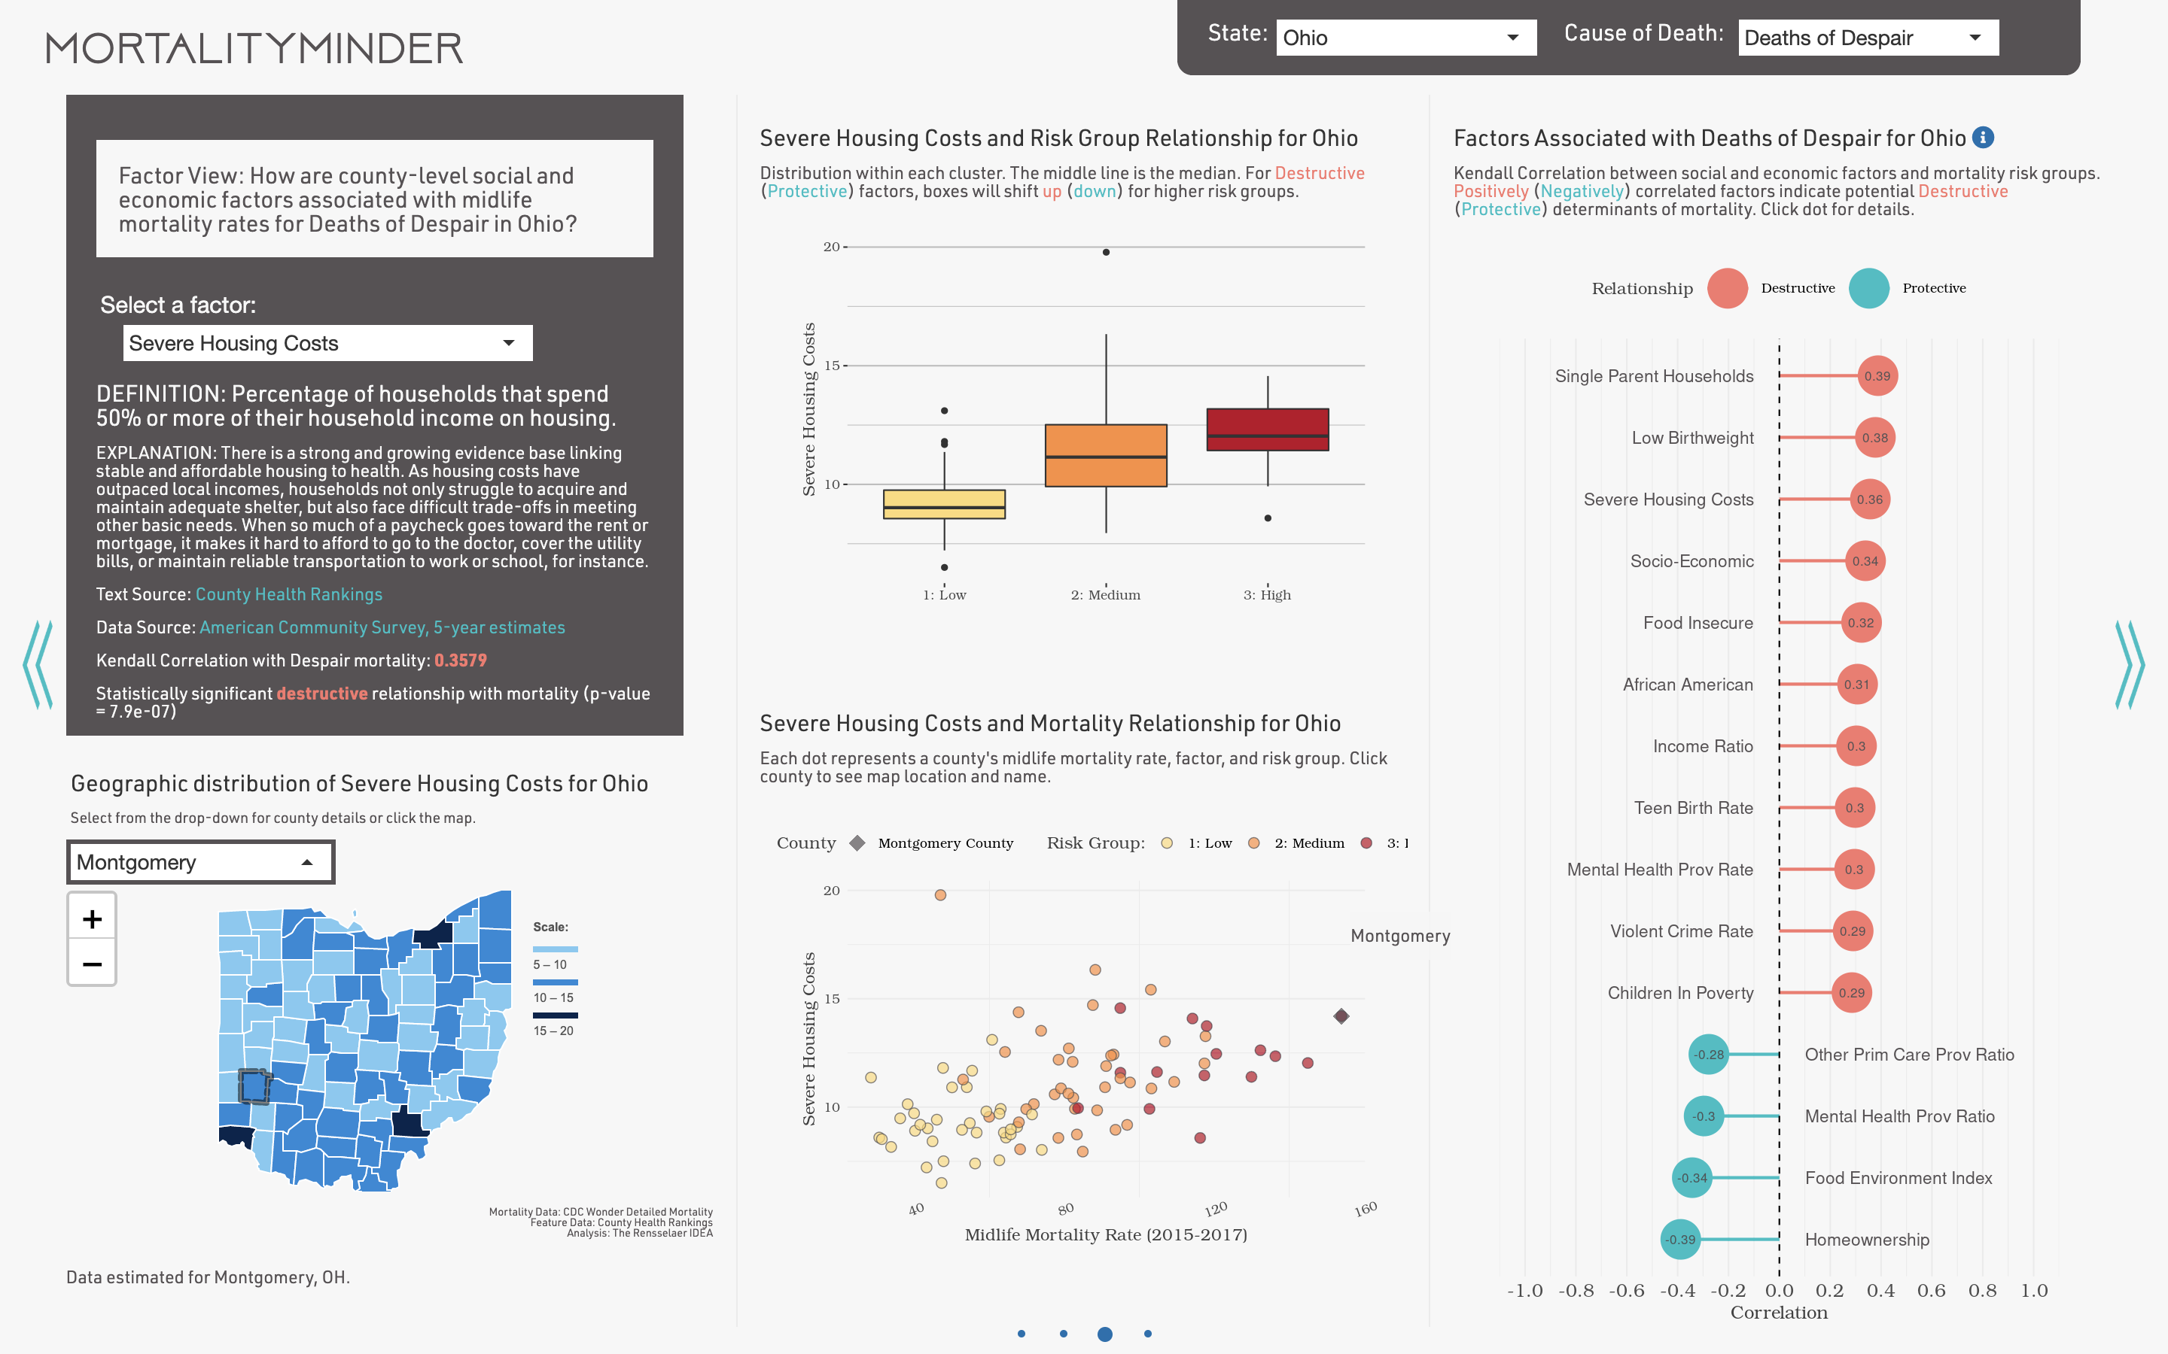
Factor View: Examines how potential determinants are associated with midlife mortality
Box plots show distribution within each Risk Group of the selected Factor.
Factor Analysis shown for reference.
Select Factor.
Report on Factor with definitions, links to sources, correlation with significance, and maps.
Select a county using dropdown or by clicking on any map for county rates.
Scatter plot shows relationship between selected Factor, Risk Cluster and Mortality Rate. Dots represent counties.
Selected county is highlighted on plot.

Slide 7
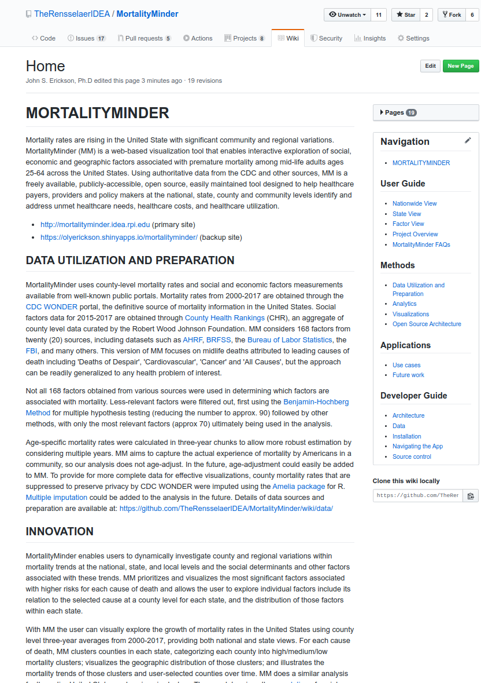
Implementation as Public Open Source Project
Best-practice code and full documentation available on Github
Implemented in open source R language and environment for statistical computing and graphics using standard packages.
Evolves rapidly based on feedback from users.
Highly Interactive Design
Combines R's Shiny platform with popular Javascript frameworks to provide a modern, highly interactive user experience.
Phase 2 design based on Formal Usability Study (25+ users) and recommendations of advisory board of healthcare professionals and designers.
Easily Customized, Reusable, and Maintainable Framework
Agile development can include new data streams, analyses, visualizations, and health care problems.
Readily ingests reliable high-quality surveillance data from wonder.cdc.org and over 20 sources via CountyHealthRankings.org

Slide 8
Insights
MortalityMinder documents the disturbing rise in midlife Deaths of Despair due to suicide, overdose, and self-harm and as well as other national/regional increases in midlife mortality rates due to Cancer, and Cardiovascular Disease, and All Causes.
Highlights potential social determinants through statistical analysis of factors associated with disparities in regional trends in mortality rates.
Provides county-level confirmation of trends and hypothesized causes.
Insights can be used to create region-specific interventions and best practices.
Confirms the midlife mortality rate increases reported in Wolf and Schoomaker, JAMA 2019, but provides much greater insights into community-level variations and their associated factors to help determine remedies.
Enables rigorous analysis of potential determinants of health by local, state, and national healthcare organizations to support development of programs, policies, and procedures to find and address unmet health care needs to improve longevity.

Slide 9
Tool Benefits
Repeatability and Scalability:
Analytical and visualization results are fully repeatable and reproducible, by cloning the GitHub code repository or by directly downloading results via the app.
Users can get analyses at the National, State, and County levels.
The app will scale based on the hosting resources available. It was developed, tested and hosted for the competition on multi-core servers, but performs well on personal machines.
Similar apps could be developed for other health trends and associated social determinants by adding data sources.
Future Deployment:
MortalityMinder is currently hosted on a virtual server at Rensselaer and at Shinyapps.io.
MortalityMinder continues as an open source project dedicated to improving life expectancy in the United States.
The app continuously evolves in an agile framework to incorporate user feedback and introductions of new data streams, analyses, visualization, and health care problems.
The innovative visualizations and analytics in MortalityMinder can be customized and/or incorporated into other applications by using the provided code.
App is designed for use on laptops and monitors. Mobile devices are left as future work.

Slide 10
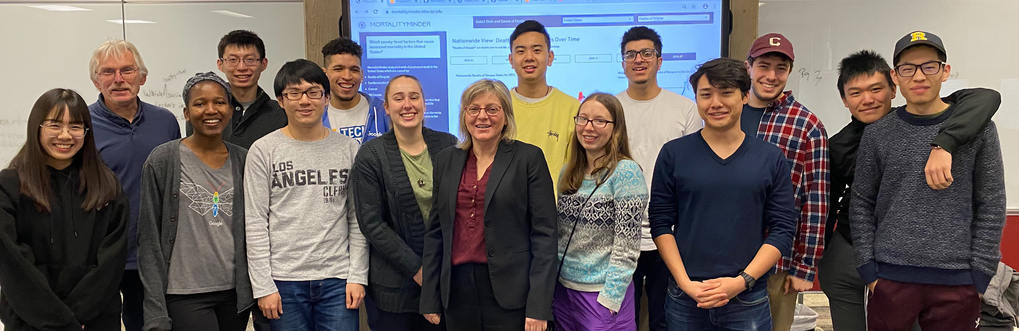
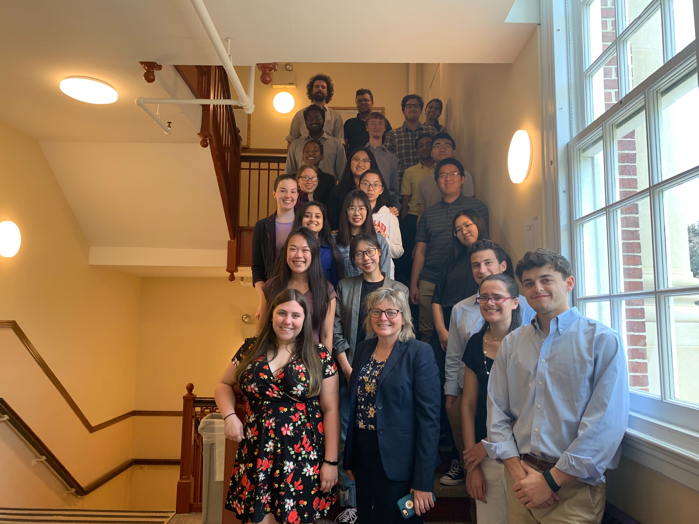
Further Information
MortalityMinder public deployments:
https://mortalityminder.idea.rpi.edu/
https://olyerickson.shinyapps.io/MortalityMinder/
Overview Video
http://bit.ly/mortalityminder_video_final
MortalityMinder Open Source GitHub:
https://github.com/TheRensselaerIDEA/MortalityMinder
Full documentation provided on GitHub Wiki
https://github.com/TheRensselaerIDEA/MortalityMinder/wiki
MortalityMinder was created by undergraduate and graduate students in the Health Analytics Challenge Lab at Rensselaer Polytechnic Institute with support from the United Health Foundation and the Rensselaer Institute for Data Exploration and Applications. MortalityMinder was directed by Kristin P. Bennett and John S. Erickson. Many thanks to the MortalityMinder Advisory Board: Ms. Anne Yau, United Health Foundation; Dr. Dan Fabius, Continuum Health; Ms. Melissa Kamal, New York State Department of Health; and Dr. Tom White, Capital District Physicians' Health Plan.
Refer questions to erickj4@rpi.edu. Submit user requests to GitHub.

